Slide 1
HEART DISEASE PREDICTION
PIP104 PROFESSIONAL PRACTICE-II
VIVA-VOCE
Batch Number:05
Roll Number | Student Name
20201COD0019 | Y. Remanth kumar
20201COD0025 | C. Charan Sai
20201COD0024 | M. Bhuvaneshwar
20201COD0013 | Y. Gnaneshwar Reddy
Under the Supervision of,
Mr.PAJANY M
Assistant Professor
School of Computer Science and Engineering
Presidency University Bengaluru

Slide 2
Introduction
Due to busy schedule as well as routine assignments peoples are facing severe stress and anxiety. More over some other peoples are addicted with chronic habitual behaviour like consumption of Cigars and Gutka those peoples are suffering from chronic diseases like, heart diseases, cancer, Liver problems, Kidney failures etc. To cure such persons with chronic disease is a big hurdle to well know doctors, is a current world issue. Regarding this new challenge, IT professionals are provided hand to hand support to predict such disease early and cure as well as recover the patients from the chronic disease. In the present scenario each humans are so exceptional in his individual features and manners, but even though every humans may have different pulse rate as well as blood pressure ratings. Based on the history and generic evaluation of medical practitioners and researchers believed that, a healthy humans pulse rate is varied in between of 60 to 100 bpm and BP is varied in between of 120/80 to 140/90 (mm Hg), and these readings are proved by medical practitioners. Heart syndrome is one the vital abrupt death or accidental death of humans in this world, this is might be because of poor dieting as well as physical.

Slide 3
Literature Review
Authors | Title | Conference/Journal | Algorithms Used | Key Findings
P. Kola Sujatha and K. Mahalakshmi[1] | Performance evaluation of supervised machine learning... | 2020 IEEE International Conference for Innovation in | Naïve Bayes | Random Forest outperforms other algorithms with an accuracy of 83.52%, F1-Score 84.21%, AUC 88.24%, Precision 88.89%.
Pahulpreet Singh Kohli and Shriya Arora[2] | Application of machine learning in disease prediction | 2018 4th International Conference on Computing | Decision Tree classification algorithms | Machine learning can be used to detect diseases early on, using three distinct disease databases.
Abderrahmane Ed-Daoudy and Khalil Maalmi[3] | Real-time machine learning for early detection of... | 2020 5th Signal Processing and Communications | KNN | Proposes a real- time heart disease prediction system using Apache Spark for large- scale distributed computing.
A. Lakshmanarao A. Srisaila, [4] | Heart disease prediction using feature selection and... | 2020 IEEE International Conference for Innovation in | Feature selection, ensemble learning techniques | Utilizes feature selection and ensemble learning techniques for heart disease prediction.
Alperen Erdoğan and Selda Guney[5] | Heart disease prediction by using machine learning... | 2020 28th Signal Processing and Communications | Support Vector Machine, Random Forest, Decision Tree | Explores the use of machine learning algorithms for heart disease prediction.
Shaik Farzana and Duggineni Veeraiah[6] | Dynamic heart disease prediction using multi- machine... | 2020 5th International Conference on Computing | Multi-machine learning techniques | Proposes a dynamic approach to heart disease prediction using multi-machine learning techniques.

Slide 4
Research Gaps Identified
Research in predicting heart disease has made significant strides, yet persistent gaps in understanding and refining predictive models remain. One key area of improvement involves the integration of diverse data sources. While existing models often rely on demographic information and limited biomarkers, incorporating a wider array of data, such as genomics, environmental factors, and socio-economic indicators, could provide a more holistic understanding of risk factors contributing to heart disease.
Ethnic and racial disparities in heart disease risk are inadequately addressed in current predictive models, often due to underrepresentation in datasets. Addressing these disparities requires research focused on understanding the unique risk profiles within diverse populations and developing personalized predictive models that cater to their specific needs.

Slide 5
Proposed Methodology
1.A Heart Disease Dataset is taken
2.The dataset is loaded and preprocessed with various machine learning technique
3. The dataset is loaded and preprocessed with various machine learning technique
4.The prediction model is built using machine learning algorithms like Logistic Regression, KNN, SVC, Random Forest ,Decision Tree, Naive Bayes and XGB Classifier
5.The model is trained using training dataset and once the model has been trained successfully it has to be tested

Slide 6
Proposed Methodology
6. The trained model is tested using testing dataset and accuracy is calculated.
7. The algorithm which gives the best accuracy is taken as our final prediction model
8. The finalized model is converted into pickle model (binary format data) and saved.
9.A Front End is developed with the help of Flask and HTML.
10. Now user will enter the various parameters required to predict the heart disease in the front end.
11.The collected parameters from the front end are given as input to our finalized algorithm to predict whether the person has the heart disease or not

Slide 7
Objectives:
The primary goal of this project is to use machine learning techniques and algorithms, such as KNN, SVM, Random Forest, Decision Tree, and Naïve Bayes, to predict the Heart Disease based on various parameters that the user enters in the front end. Mainly we have to use “RANDOM FOREST ALGORITHM” because of high accuracy levels.. K-Nearest Neighbors (KNN):The k-nearest neighbors (KNN) algorithm is a simple, easy-to-implement supervised machine learning algorithm that can be used to solve both classification and regression problems. A supervised machine learning algorithm (as opposed to an unsupervised machine learning algorithm) is one that relies on labeled input data to learn a function that produces an appropriate output when given new unlabeled data.

Slide 8
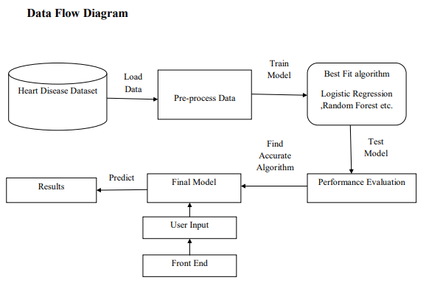
System Design & Implementation
SYSTEM DESIGN:

Slide 9
Implementation:
PYTHON:
Python is an interpreted, object-oriented, high-level programming language with dynamic semantics. Its high-level built in data structures, combined with dynamic typing and dynamic binding, make it very attractive for Rapid Application Development, as well as for use as a scripting language. Python's simple, easy to learn syntax emphasizes readability and therefore reduces the cost of program maintenance. Python supports modules and packages, which encourages program modularity and code reuse. The Python interpreter and the extensive standard library are available as open source.
Python is widely considered as the preferred language for teaching and learning ML (Machine Learning).

Slide 10
PYTHON IDLE:
• An IDE (or Integrated Development Environment) is a program dedicated to software development.
• IDEs integrate several tools specifically designed for software development. These tools usually include:
• An editor designed to handle code (with, for example, syntax highlighting and auto-completion)
• Build, execution, and debugging tools
• Some form of source control
• When you install Python, IDLE is also installed by default.
• Its major features include the Python shell window(interactive interpreter), auto-completion, syntax highlighting, smart indentation, and a basic integrated debugger.
• we used 3.6.8 version

Slide 11
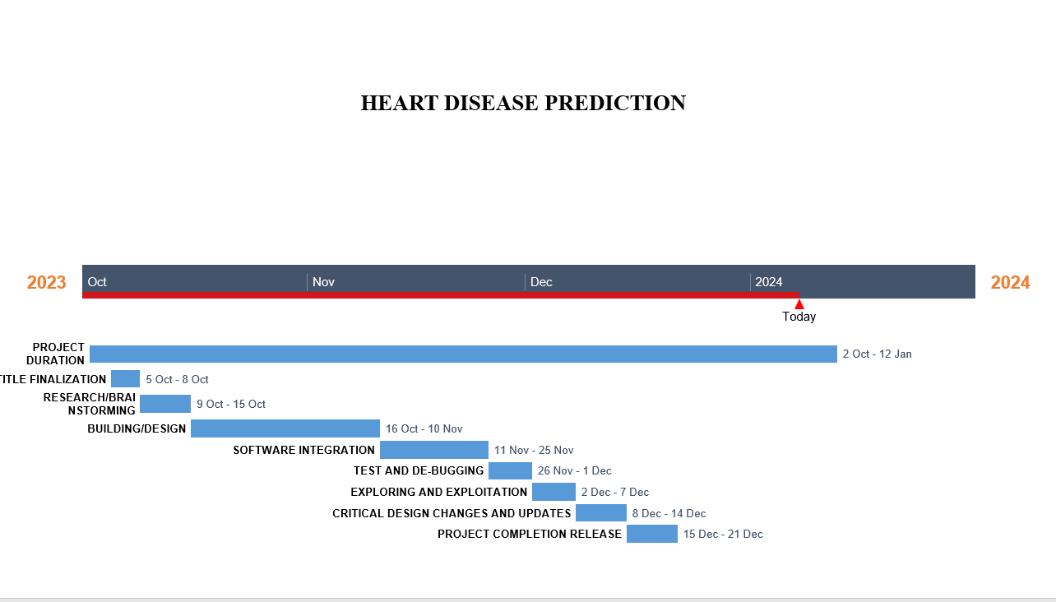
Timeline of Project
Link:
https://online.officetimeline.com/shareable-link?token=YE%2fGVyIrIQ%2fqs96hj25DTmfKEFPmb7i%2fGD4UOpyAzMFJ347llYlONSDsgapqI3qm3n4x3u9O0uW5cSsPIboRAcWjPOGZ38HiA6JxFy7QnI8Y7Pwgqyeh0Bhz6JLb1SN3

Slide 12
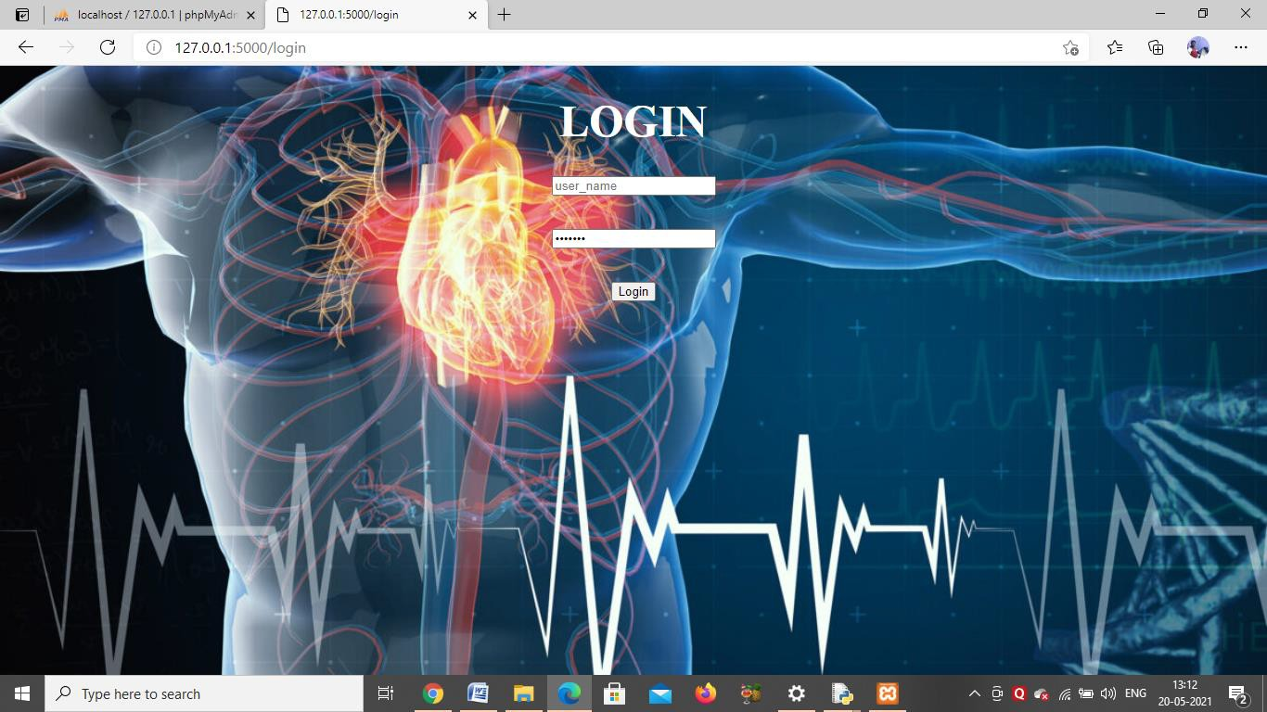
Outcomes / Results Obtained

Slide 13
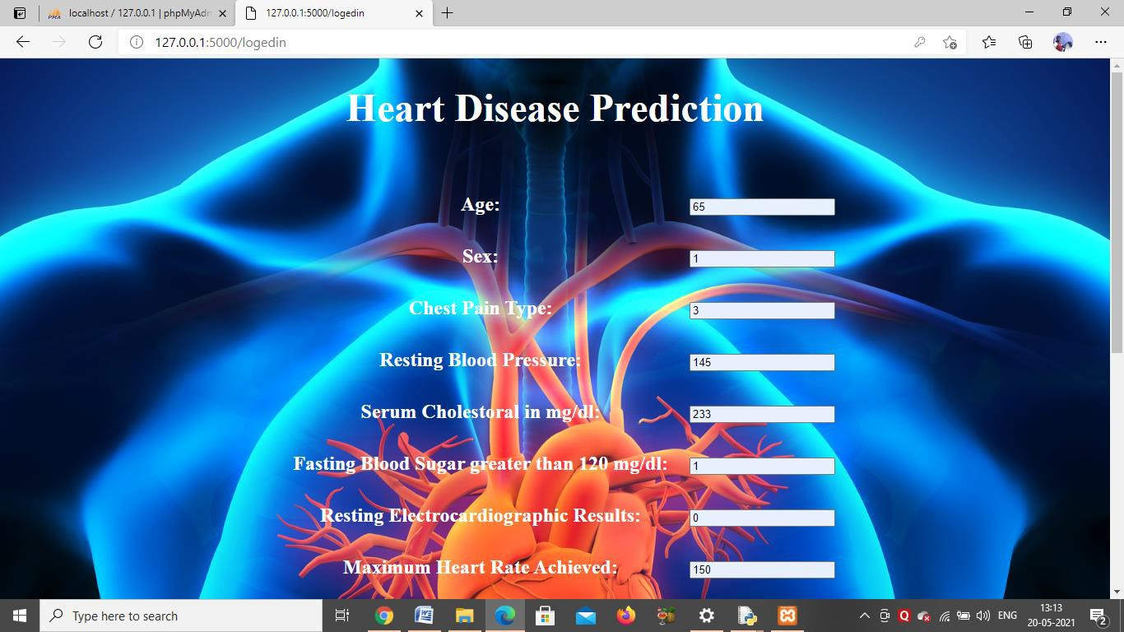
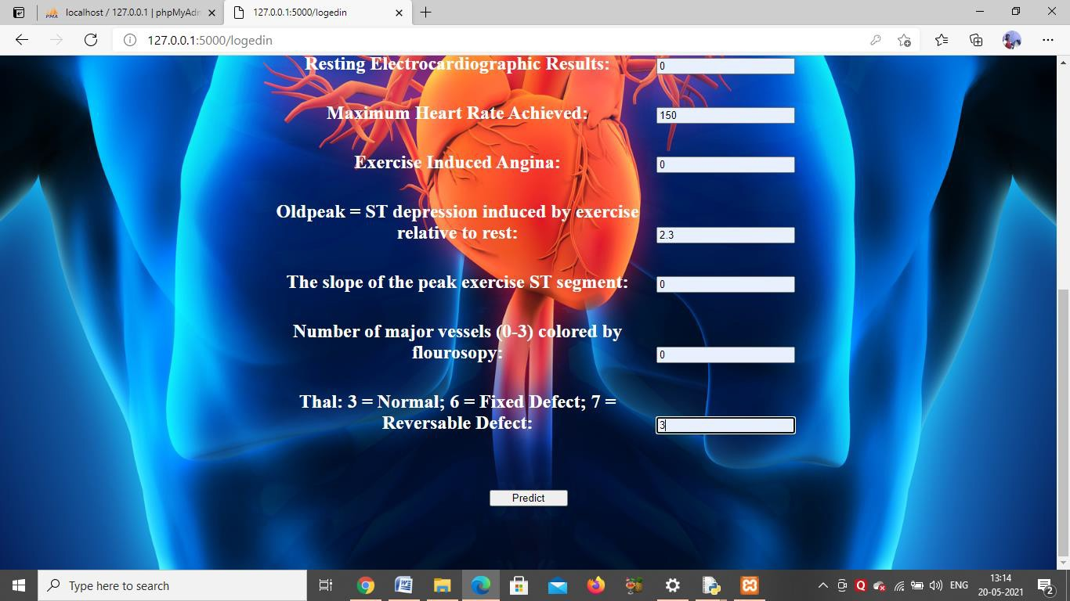
FINAL OUTPUT OF THE: PROJECT:

Slide 14
Conclusion
In conclusion, the proposed system harnesses the power of various machine learning algorithms to predict heart disease based on user-entered parameters. The integration of Logistic Regression, KNN, SVC, Random Forest, Decision Tree, XGB Classifier, and Naïve Bayes contributes to a comprehensive and accurate prediction model.
The importance of early detection in mitigating the severity of heart disease cannot be overstated. Our system, implemented and tested, achieves a commendable accuracy of 91.80percent, particularly attributed to the Random Forest Classifier. This high accuracy underscores the efficacy of machine learning in healthcare applications.
The user-friendly front end, implemented using Flask, HTML, and pymyspl, facilitates seamless interaction for data input and retrieval of predictions. The system also incorporates data preprocessing steps, including handling missing values, encoding categorical variables, and standardizing numerical features, ensuring the reliability of predictions.
As we move forward, continuous refinement of the model and exploration of additional features can further enhance the predictive capabilities of the system. This research stands as a testament to the synergy between healthcare and machine learning, paving the way for more sophisticated and accurate predictive models in the field of cardiology.

Slide 15
References
1. Gavhane, G. Kokkula, I. Pandya and K. Devadkar, "Prediction of Heart Disease Using Machine Learning," 2018 Second International Conference on Electronics, Communication and Aerospace Technology (ICECA), 2018, pp. 1275-1278, doi: 10.1109/ICECA.2018.8474922.
2. P. Sujatha and K. Mahalakshmi, "Performance Evaluation of Supervised Machine Learning Algorithms in Prediction of Heart Disease," 2020 IEEE International Conference for Innovation in Technology (INOCON), 2020, pp. 1-7, doi: 10.1109/INOCON50539.2020.9298354.
3. P. S. Kohli and S. Arora, "Application of Machine Learning in Disease Prediction," 2018 4th International Conference on Computing Communication and Automation (ICCCA), 2018, pp. 1-4, doi: 10.1109/CCAA.2018.8777449.
4. A. Ed-Daoudy and K. Maalmi, "Real-time machine learning for early detection of heart disease using big data approach," 2019 International Conference on Wireless Technologies, Embedded and Intelligent Systems (WITS), 2019, pp. 1-5, doi: 10.1109/WITS.2019.8723839.
5. A. Lakshmanarao, A. Srisaila and T. S. R. Kiran, "Heart Disease Prediction using Feature Selection and Ensemble Learning Techniques," 2021 Third International Conference on Intelligent Communication Technologies and Virtual Mobile Networks (ICICV), 2021, pp. 994-998, doi: 10.1109/ICICV50876.2021.9388482.
6. A. Erdoğan and S. Güney, "Heart Disease Prediction by Using Machine Learning Algorithms," 2020 28th Signal Processing and Communications Applications Conference (SIU), 2020, pp. 1-4, doi: 10.1109/SIU49456.2020.9302468. 7. S. Farzana and D. Veeraiah, "Dynamic Heart Disease Prediction using Mu

Slide 16
Publication Details
IJCRT:International Journal of Creative Research Thoughts (IJCRT) ISSN: 2320-2882 | Impact Factor: 7.97 | Impact Factor: 7.97 and Monthly-Peer-reviewed, and Refereed Journals. Open Access Processing Charges or Publication fees with free DOI : ₹1500 INR for Indian author & 55$ for foreign International author.
Paper RegistrationID:IJCRT_249062
Track your paper: https://ijcrt.org/track.php?r_id=249062
Paper Title: Heart Disease Prediction
Corresponding Author’s Name :MATAM BHUVANSHWAR

Slide 17
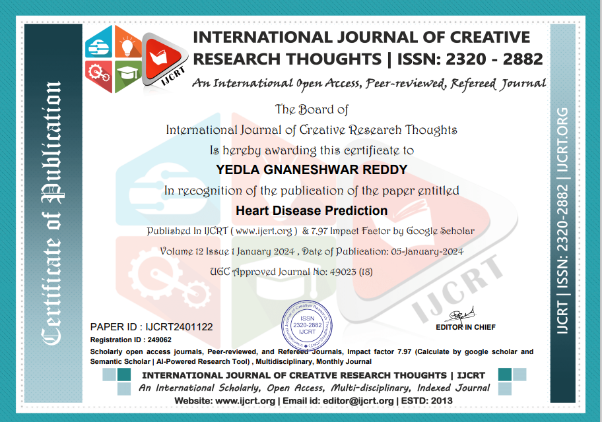

Achievements

Slide 18
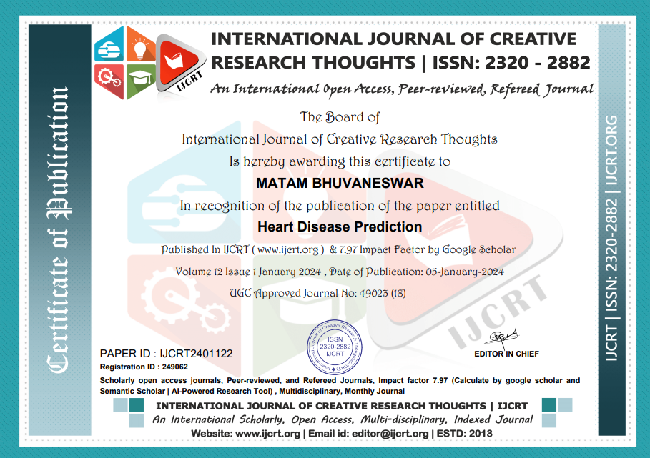
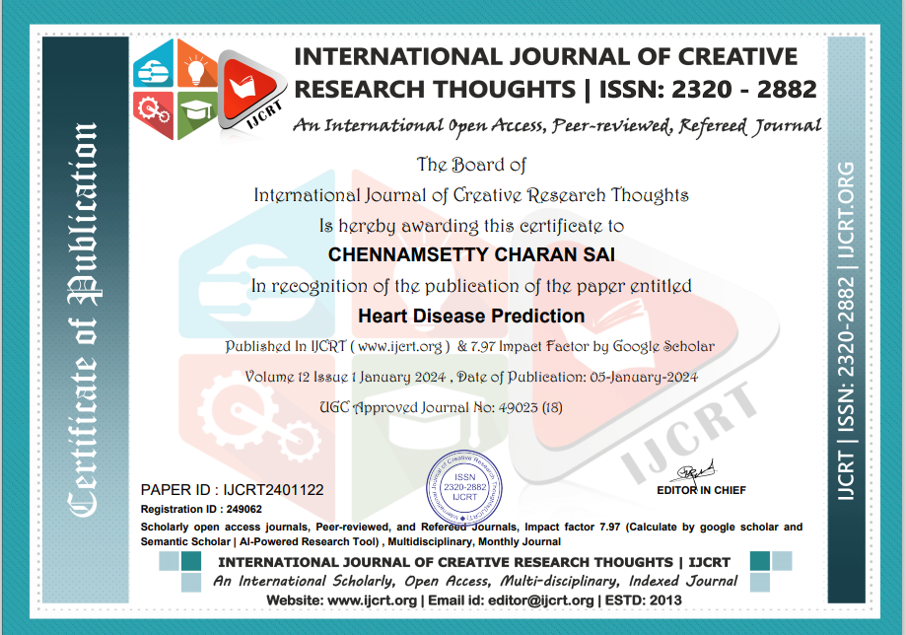

Slide 19

Thank You

